Slide 1
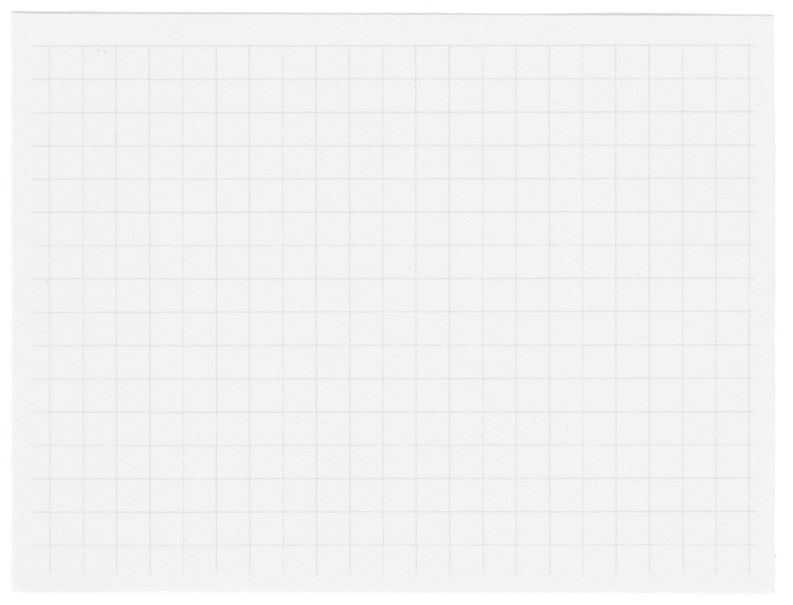
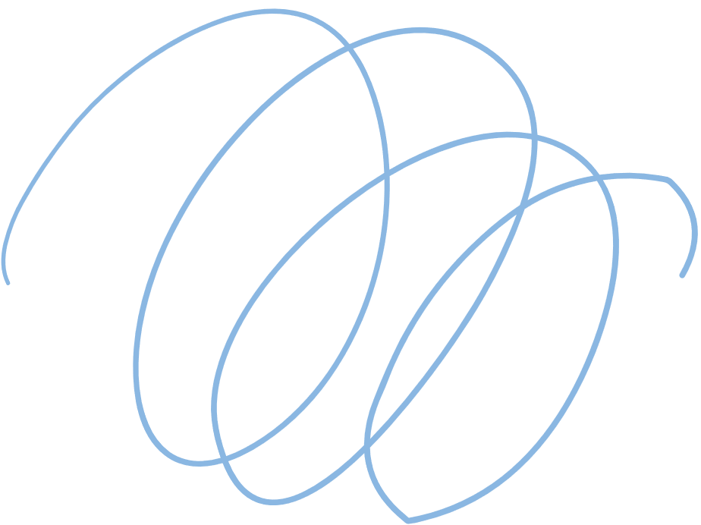
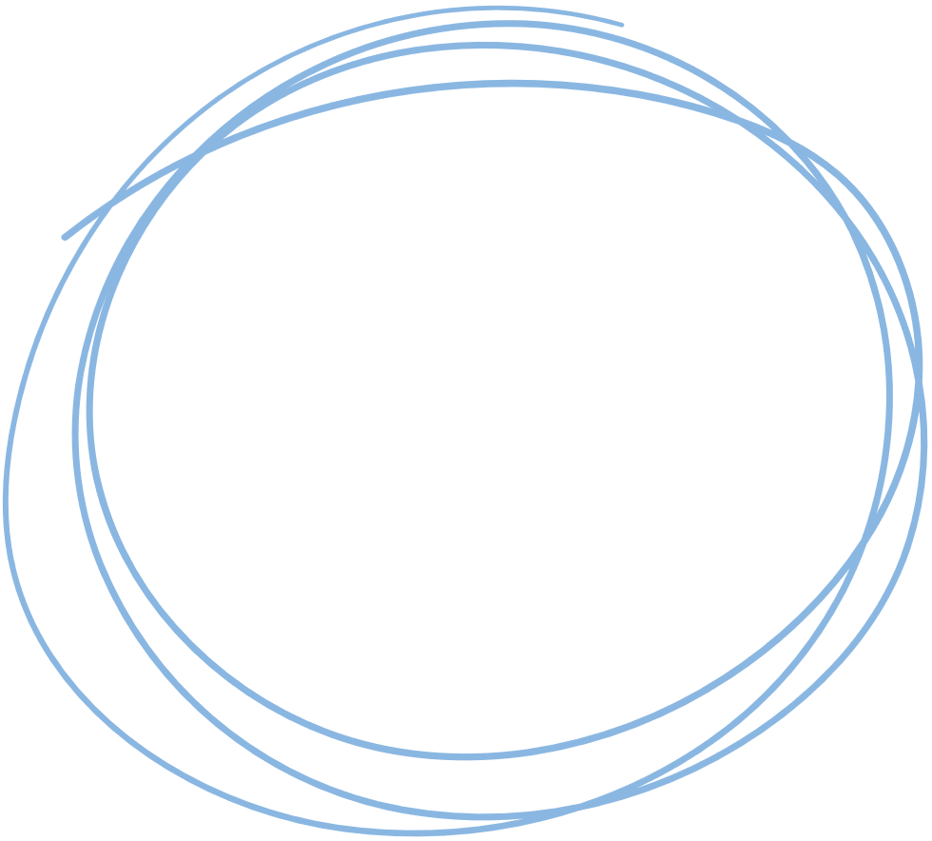

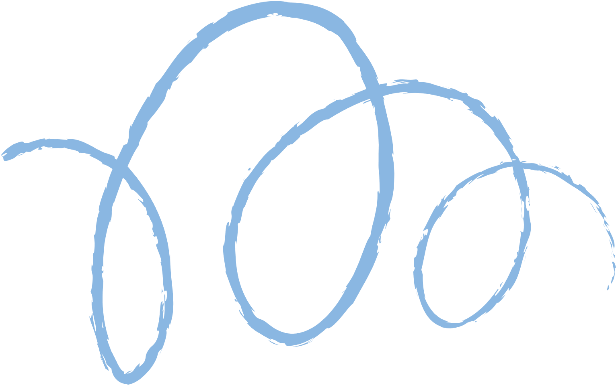



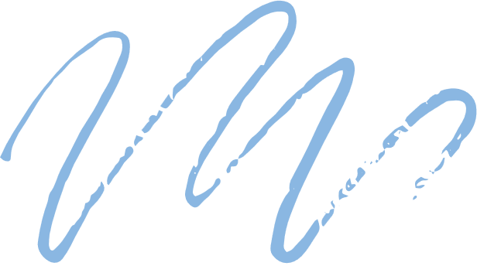




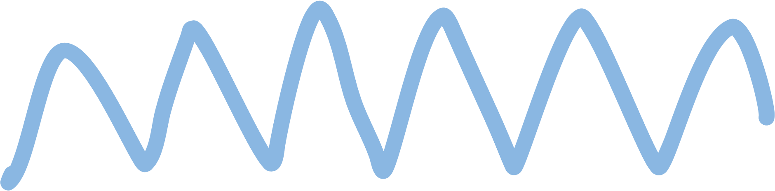

EE675 Project Report
Optimization on Graphs using Decentralized/Distributed RL
Instructor: Dr. Subrahmanya Peruru
Shivam Gupta - 210980
Monkesh Singh - 210631
Harshit Gupta - 210422

Slide 2
Link for presentation video:
https://youtu.be/sDtvw6kunVA

Slide 3
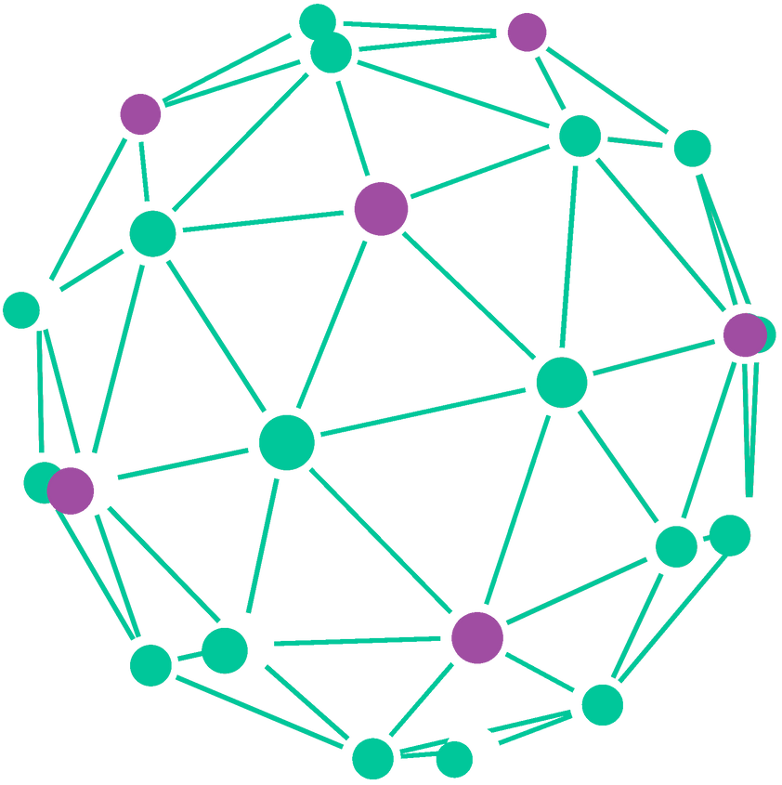
Problem Definition
Maximum Independent set(MIS)
The Maximum Independent Set (MIS) is a fundamental concept in graph theory, particularly in combinatorial optimization. It refers to the largest possible subset of vertices within a graph where no two vertices are adjacent to each other.

Slide 4
Importance/Applications of MIS
Graph coloring
Social Network Analysis
Resource Allocation in Computing Systems

Slide 5
Available Solutions
Exact solutions
Approximate solutions
Branch-and-Bound: This method systematically explores the solution space by dividing it into smaller subproblems and pruning branches that cannot lead to an optimal solution.
Dynamic Programming: Utilizes memoization to efficiently solve subproblems, typically used when the graph has certain structural properties.
Greedy Algorithms: These algorithms iteratively build the independent set by greedily selecting vertices that maximize the set size. Though not guaranteed to find the maximum, they often provide reasonable solutions quickly.
Local Search Algorithms: Start with an initial solution and iteratively improve it by making local changes. Examples include Simulated Annealing and Genetic Algorithms.
There are many more solutions available but we are going to look at a solution involving reinceforcement learning available at https://proceedings.mlr.press/v119/ahn20a/ahn20a.pdf

Slide 6
Learning What to Defer (LwD)
algorithm for
Maximum Independent Set

Slide 7
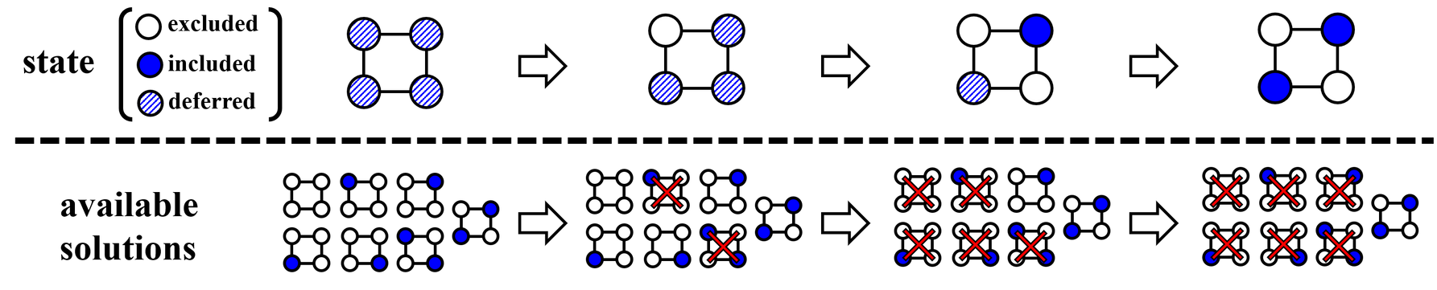
MDP Dynamics
We formulate the proposed algorithm as a pair of a MDP and an agent, i.e., a policy. At a high level, the MDP initializes its states on the given graph and generates a solution at termination. We further decompose the MIS objective into a summation of rewards distributed over the MDP.

Slide 8
1. State
Each state of the MDP is represented as a vertex-state vector s = [si : i ∈ V] ∈ {0, 1, ∗}V , where the vertex i ∈ V is determined to be excluded or included in the independent set whenever si = 0 or si = 1, respectively. Otherwise, si = ∗ indicates that the determination has been deferred and expected to be made in later iterations. The MDP is initialized with the deferred vertex-states, i.e., si = ∗ for all i ∈ V, and terminated when (a) there is no deferred vertex-state left or (b) time limit is reached.

Slide 9
2. Action
Actions correspond to new assignments for the next state of vertices. Since vertex-states of included and excluded vertices are immutable, the assignments are defined only on the deferred vertices. It is represented as a vector a∗ = [ai : i ∈ V∗] ∈ {0, 1, ∗}V∗ where V∗ denotes a set of current deferred vertices, i.e., V∗ = {i : i ∈ V, xi = ∗}.

Slide 10
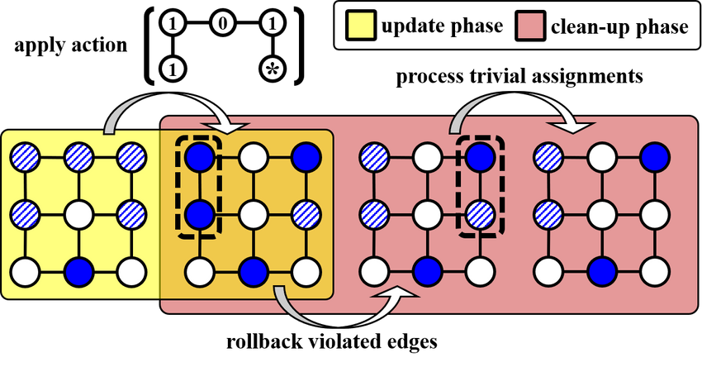
3. Transition
Given two consecutive states s, s 0 and the
corresponding assignment a∗, the transition
Pa∗ (s, s 0 ) consists of two deterministic phases:
the update phase and the cleanup phase. The update phase takes account of the assignment a∗ generated by the policy for the corresponding vertices V∗ to result in an intermediate vertex-state sb, i.e., sbi = ai if i ∈ V∗ and sbi = si otherwise. The clean-up phase modifies the intermediate vertex-state vector sb to yield a valid vertexstate vector s 0 , where the included vertices are only adjacent to the excluded vertices. To this end, whenever there exists a pair of included vertices adjacent to each other, they are both mapped back to the deferred vertex-state. Next, the MDP excludes any deferred vertex neighboring with an included

Slide 11
3. Transition (cont.)
When the MDP makes all the determination, i.e., at termination, one can (optionally) improve the determined solution by applying the 2-improvement local search algorithm (Feo et al., 1994; Andrade et al., 2012); it increases the size of the independent set greedily by removing one vertex and adding two vertices until no modification is possible.

Slide 12
4. Reward
Finally, we define the cardinality reward R(s, s 0 ) as the increase in cardinality of included vertices. To be specific, we define it as R(s, s 0 ) = P i∈V∗\V0 ∗ s 0 i , where V∗ and V 0 ∗ are the set of vertices with deferred vertex-state with respect to s and s 0 , respectively. By doing so, the overall reward of the MDP corresponds to the cardinality of the independent set returned by our algorithm.

Slide 13
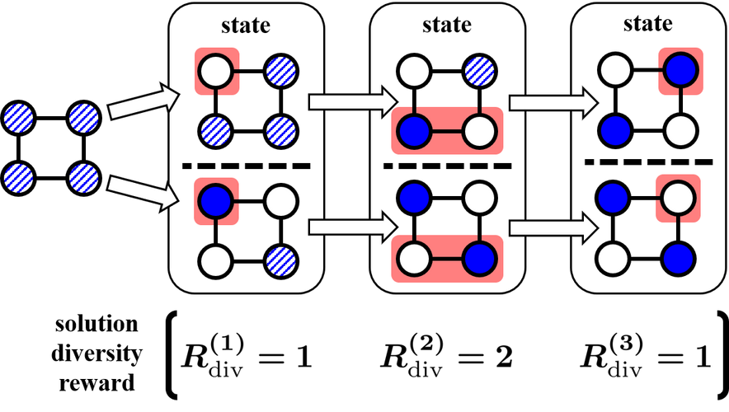
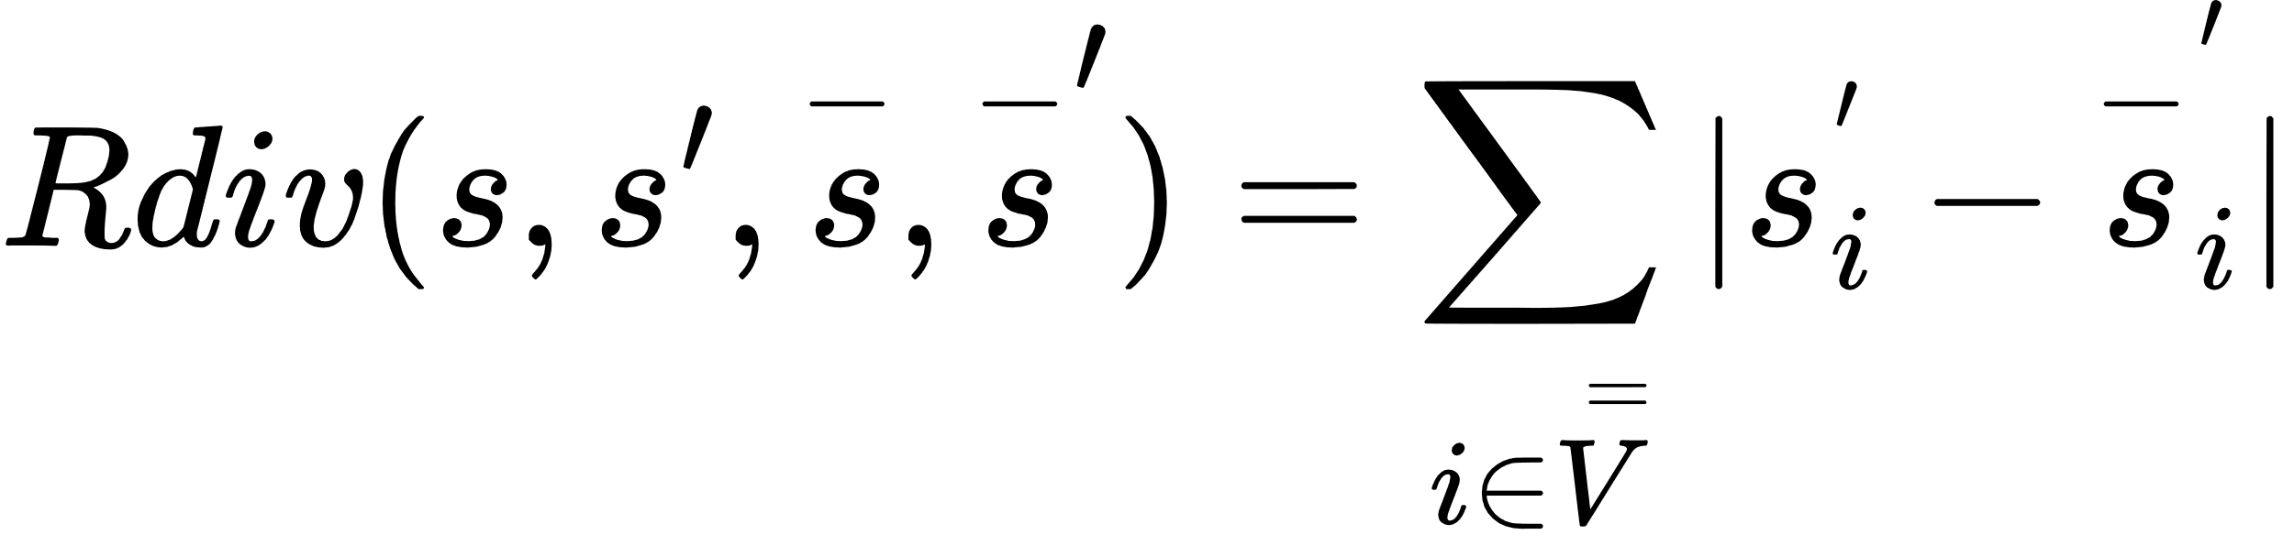
4. Reward (Diversification Reward)
We “couple” two copies of MDPs defined on an identical graph G into a new MDP. Then the new MDP is associated with a pair of distinct vertex-state vectors (s, s¯) from the coupled MDPs. Furthermore, the corresponding agents work independently to result in a pair of solutions (x, x¯). Then, we directly reward the deviation between the coupled solutions in terms of `1-norm, i.e., kx − x¯k1. To be specific, the deviation is decomposed into rewards in each iteration of the MDP defined by
where Vb = (V∗ \ V0 ∗ ) ∪ (V¯ ∗ \ V¯0 ∗ ) and (s 0 , s¯ 0 ) denotes the next pair of vertex-states in the coupled MDP.

Slide 14
Brief Intro to PPO
Policy Gradient Method: PPO belongs to the class of policy gradient methods, which directly optimize the policy function to maximize expected rewards.
Gradient Ascent: PPO iteratively updates the policy parameters in the direction that increases the expected return by computing and ascending the gradient of the expected return with respect to the policy parameters.
Stochastic Policy: PPO often learns a stochastic policy, meaning it outputs a probability distribution over actions for a given state, allowing for exploration and uncertainty handling.
Parameterized Policy: PPO represents the policy function using a parameterized model, such as a neural network, where the parameters are adjusted to improve performance over time.
Policy Optimization Objective: PPO maximizes an objective function that encourages the policy to increase the probabilities of actions with higher rewards and decrease the probabilities of actions with lower rewards.

Slide 15
Brief Intro to PPO (cont.)
PPO consists of two networks
Policy Network
The Policy Network in PPO learns the optimal policy, which is the mapping from states to actions.
It takes state observations as input and outputs a probability distribution over possible actions.
The Policy Network is updated using policy gradient methods to maximize the expected return, guiding the agent's decision-making process.
Value Network
The Value Network in PPO estimates the expected return or value of being in a particular state.
It takes state observations as input and outputs the estimated value of the state.
The Value Network is updated using methods like temporal difference learning to minimize the difference between predicted and actual returns, providing valuable feedback for policy updates.
The Policy Network uses the Value Network's estimates to make better decisions.
while the Value Network uses the policy from the policy network to estimate the value function of being in a particular state.

Slide 16
Training
MDP is trained using Proximal Policy Optimization algorithm
Algorithm is based on actor-critic training with policy network π(a|s) and value network V (s) following the GraphSAGE architecture
Each network consists of multiple layers h (n) with n = 1, · · · , N where the n-th layer with weights W(n) 1 and W(n) 2 performs the following transformation on input H:
where B and D correspond to adjacency and degree matrix of the graph G, respectively.

Slide 17
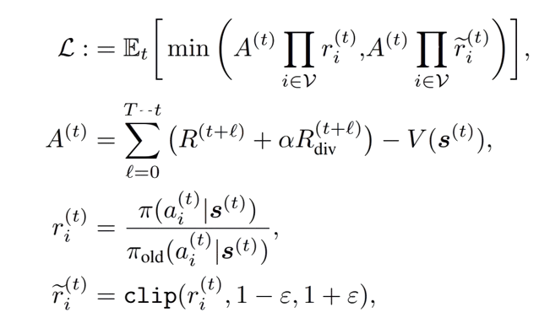
Training (cont.)
To train the agent, we use the proximal policy optimization. We train the networks to maximize the following objective:
where,
s(t) : Vertex-State Vector
a(t) : Action Vector
R(t) : Cardinality Reward
R(t)div : Diversification Reward

Slide 18
Fast Link Scheduling in Wireless Networks
using Regularized Off-Policy Reinforcement Learning
Link to the paper:
https://ieeexplore.ieee.org/document/10092874

Slide 19
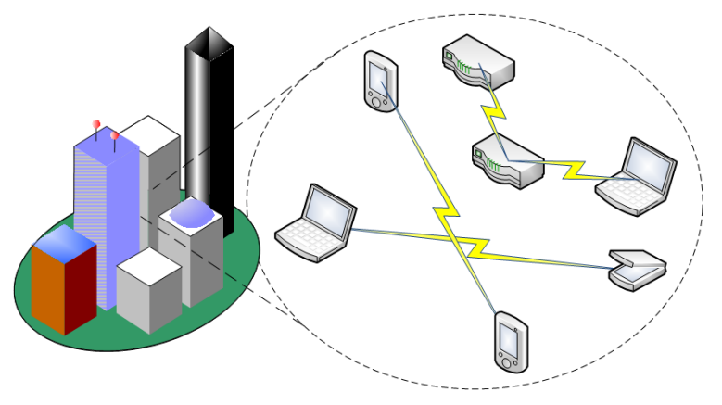
Problem Definition
Fast Link Scheduling in Wireless Networks
Fast Link Scheduling in Wireless Networks is a problem of efficiently allocating communication resources to maximize throughput and minimize interference in wireless communication systems, often addressed using optimization or reinforcement learning techniques.

Slide 20

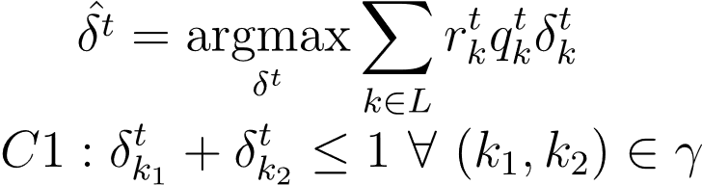
PROBLEM FORMULATION
Vertices: vertices represent the wireless links or communication channels within the network.
Edges: The edges in the conflict graph indicate the interference relationships between different wireless links. An edge between two vertices suggests that the corresponding links interfere with each other when active simultaneously.
r - denote the number of packets that can be sent successfully over the wireless link k at slot t, if none of its interfering links are transmitting.
q - denotes length of queues packet arrives at k link at t time.
u - denotes link uility,
Finding optimal schedule at slot t is equivalent to solving the MWIS problem in the conflict graph G = (L, γ)
t
k
t
k
t
k

Slide 21



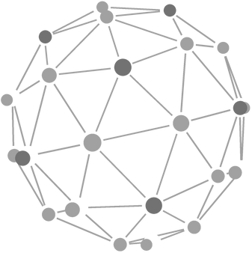
Problem Solution
The problem is formulated as MDP, which is similar to paper 1
Each vertice have a label {-1,0,1}, for Not included, undecided, included respectively
State - State at nth round denotes subgraph formed by undecided vertices
Action - At the nth round, assign label {-1,0,1} to each vertices in the state
State Transition - State transition from current state to next state via intermediate state where a clean-up process takes place
Reward - The reward is defined as the change in the sum of weights of the included vertices in the MWIS on state transition
The problem is solved by Off-Policy Regularized Deep Reinforcement Learning
We can design an off-policy algorithm, where a prior policy is used to generate the current actions, and they are used to train and improve the current policy
Regularizer - A regularizer used to make sure that prior policy do not have much variation when compared with updated policy
They defined a loss function and used it to train a Neural Network

Slide 22
Luby’s Alg. for Maximal Independent Sets using Pairwise Independence
using a parallel algorithm
Link to the paper:
https://ieeexplore.ieee.org/document/10092874

Slide 23
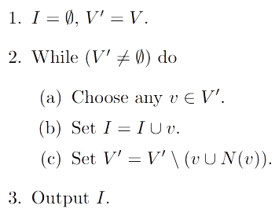
Algo. Description
There are easy ways to find MIS. For example, one algorithm is shown below

Slide 24
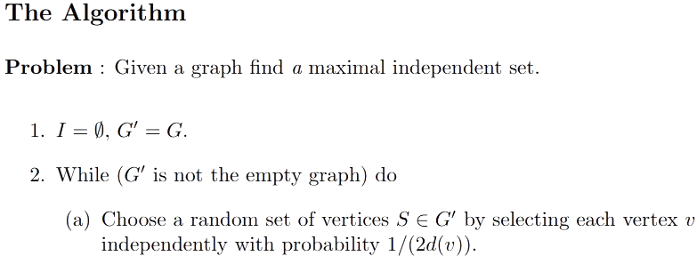
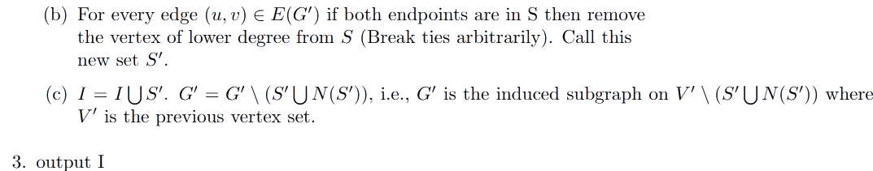
Proposed Algo

Slide 25
Future Work
What we will be doing for final report

Slide 26
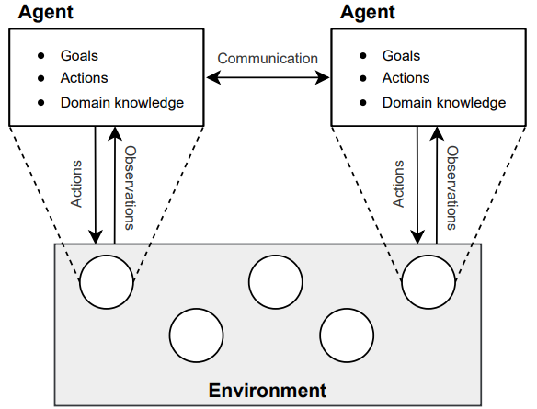
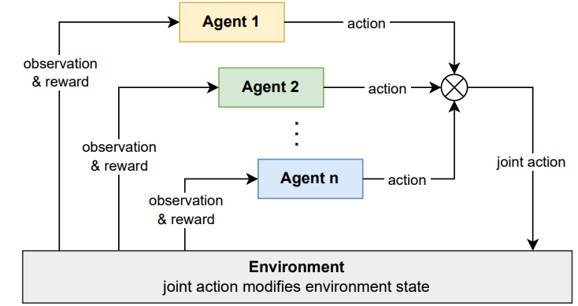
Multi Agent RL Approch
We have to find a decentralized solution, Therefore we are exploring a multi-agent approach instead of single agent
The provided Multi-Agent RL book provides knowledge of how Multi-Agent RL works
Multiple agents are present in the same environment and have their own goals, policies, and domain knowledge.
Multi-agent reinforcement learning (MARL) algorithms learn optimal policies for a set of agents in a multi-agent system

Slide 27
Multi Agent RL (Contd.)
Centralised vs Decentralised solutions
Different Dimensions in MARL, e.g., how many agents are present in the environment, and whether agents have partial knowledge or full knowledge about the environment.
Can Multi-Agent communicate with each other or work independently?
Similarly, there are different questions, and we have to select the most suitable model for our problem.

Slide 28
Future Steps
01
02
03
Reading the given Multi Agent RL Book provided in the given project paper.
Finding appropriate multi agent models which can be incorporated for our problem.
Coding and Testing it.

Slide 29
Thank you very much!

